Slide 1
Final Depth

Slide 2

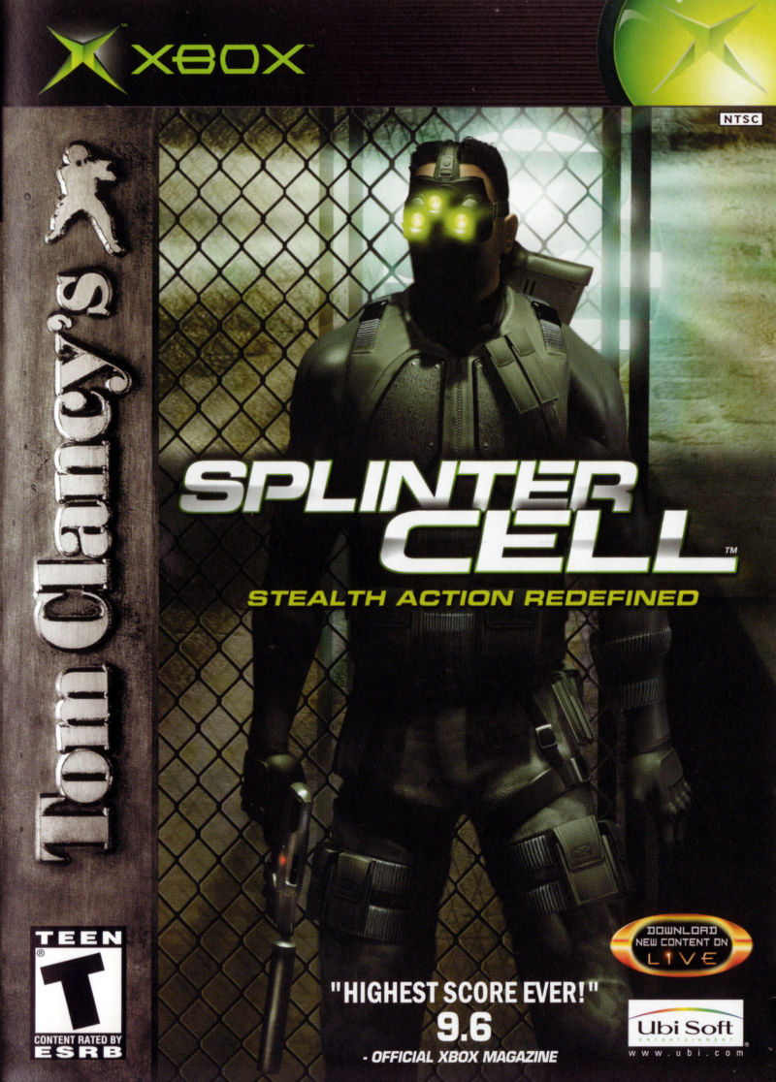
Final Depth is Bioshock crossed with Splinter cell
Final depth is a 2D Stealth action game in a futuristic underwater setting

Slide 3
Unique selling points (USP)
Explore a futuristic Underwater colony
Stealth Or Action
Large Arsenal of weapons

Slide 4
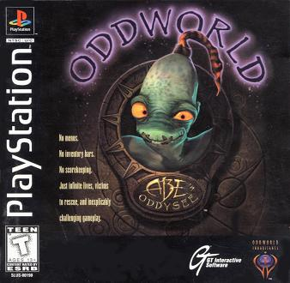
Inspirations
Bioshock
Odd World – Abe’s oddysee
Splinter cell

Slide 5
Gameplay
Stealth – Sneak around to the end of the level, while avoiding enemies and their lines of sight.
Action - Defeat all enemies in your way to make it to the end of the stage, this can be done by picking up weapon pickups.
Weapons - Both lethal and non lethal weapons are available and both have different strengths and weaknesses.
Ammo – When a weapon is picked up it cannot be reloaded, meaning that once all the bullets in a gun have been used you must throw it away and find a new one.

Slide 6
Story
The game is set in the post-apocalyptic world where the surface of the planet is uninhabitable due to strong radiation levels and the human population that is left is pushed under water in large colonies. The colony that you play in is located in the Marianas Trench and is run by the tyrannical ruler only known as the dictator. Your task is to put a stop to him.

Slide 7
Characters
Main Character/Protagonist – B10-Z4P, A Security Robot that is pushed to help a resistance to help fight against The Dictator.
Antagonist – The Dictator, The tyrannical leader that rules over the marinas trench colony with a corrupt military force.

Slide 8
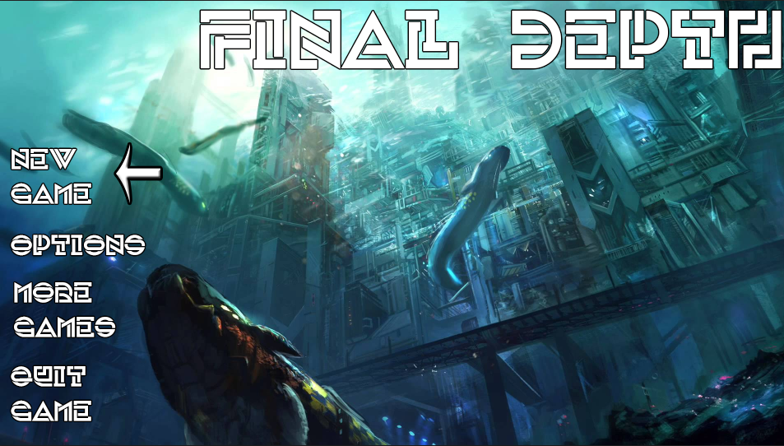
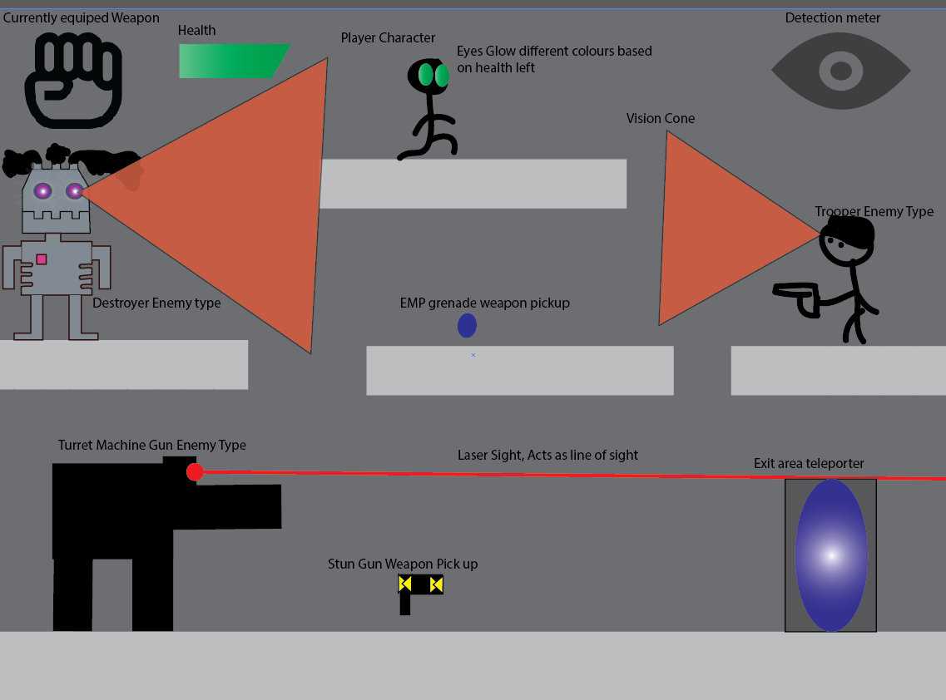
Screen Mock Ups
Main Menu
Level Mock Up

Slide 9

Target Audience
Final Depth offers challenge for players that like stealth games and planning ahead or action games and defeating as many enemies as possible.
Age wise it is targeted at ages +12.

Slide 10



Target Platform
The main focus of this game is mobile platforms, such as ITunes, google play and the windows store.
This game can also be ported to web browsers if enough interest is shown.

Slide 11
Market Research
Oddworld Abe’s Oddysee – Released on Sony's PlayStation and Windows PC’s in 19 September 1997. It sold a total of 1.24 Million Copies worldwide during its lifetime.
Bioshock – Released on XBOX 360, PlayStation 3 and Windows PC’s in August 21, 2007. It sold 4 Million copies worldwide during its lifetime.
Splinter Cell – Released on the Original Xbox, Windows PC’s, Mac, PlayStation 2, GameCube and Game Boy Advance, on November 17, 2002, and Has sold over 3 million copies worldwide during its lifetime.
CounterSpy – Released on PlayStation 3, PlayStation 4, PlayStation Vita, Android and iOS In 19th August 2014. There are no sales figures for this game but from all of the platforms that it is available on, most of the reviews show that it was well received by players

